Slide 1

Evolutionary algorith for the Game of Nim
Alessandro De Marco - 317626

Slide 2

Best strategies
Key Concept: The winning strategy for Nim revolves around the concept of "Nim Sum", calculated using the bitwise XOR operation.
Nim Sum Calculation: Convert the number of items in each pile to binary, and then perform a bitwise XOR (exclusive or) operation across all piles.
Winning Move:
If the Nim Sum is zero, your position is currently losing, and any move will leave a winning position for the opponent unless they make a mistake.
If the Nim Sum is non-zero, make a move that results in a new state where the Nim Sum is zero. This is always possible if the Nim Sum is non-zero.
Notes:
The optimal strategy for winning the Nim game is based on the concept of Nim sum. Nim sum involves converting each row of the game into a binary number and performing a bitwise XOR. It has been mathematically proven that to win the game of Nim, one should not select a move that results in a Nim sum of zero.
Starting from the concept of Nim sum, we can construct an individual's genome.

Slide 3

Genome definition
The genome is made of 2 parts: target_preference e target_range.
The target_preference in the genome represents an individual's tendency to aim for a specific nim_sum value after making a move, expressed as a random float between 0 and 1
The target_range in the genome defines the proportion of the total nim_sum range that an individual is willing to consider as acceptable for making a move, with the value being a float between 0 and 1 to represent the size of this acceptable subset relative to the game's full range of nim_sum possibilities.
Notes:
The genome consists of two attributes: target_preference and target_range.
Target_preference represents an individual's inclination to aim for a specific nim_sum value after making a move, expressed as a random float between 0 and 1.
Target_range defines the range of acceptable nim_sum values, starting from the target preference.

Slide 4

Target Preference
0
N
Nim sum range
0
0.4
1
I.e. target preference = 0.4
Notes:
How does target preference work? First, we start with the range of possible nim_sum values and normalize this value between 0 and 1. Target preference represents the value the individual believes is the best to choose.

Slide 5
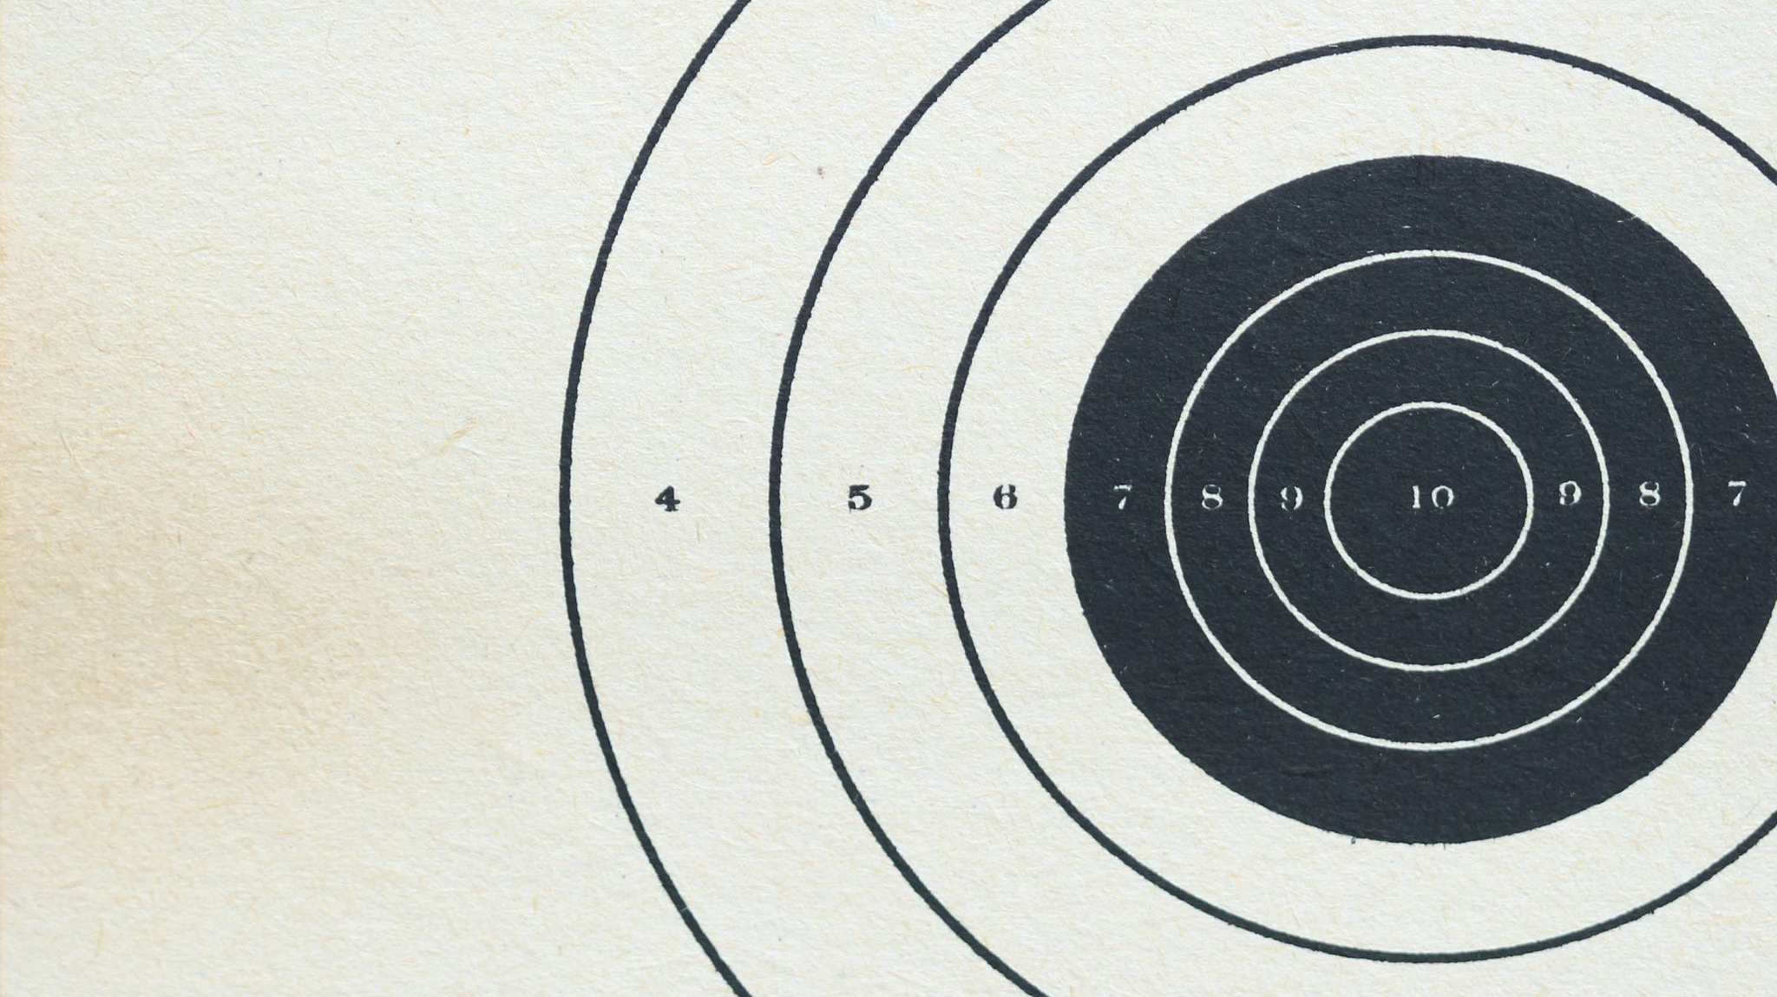
Target range
I.e. target preference = 0.4
0
0.3
0.4
0.5
1
I.e. target range = 0.2
Notes:
On the other hand, target range starts from the target preference and defines the range of values acceptable to the individual.
For example, assuming that target_preference is 0.4 and target_range is 0.2, the individual will randomly choose a value between 0.3 and 0.5. If no value is present in this range, then the individual chooses a random value.
With this genome, we have created an individual who prefers one move over all possible moves.
The fitness value in this case is the number of wins of an individual in an epoch.
Each individual will play several matches in an epoch against the optimal algorithm. These matches will determine the fitness of these individuals.

Slide 6
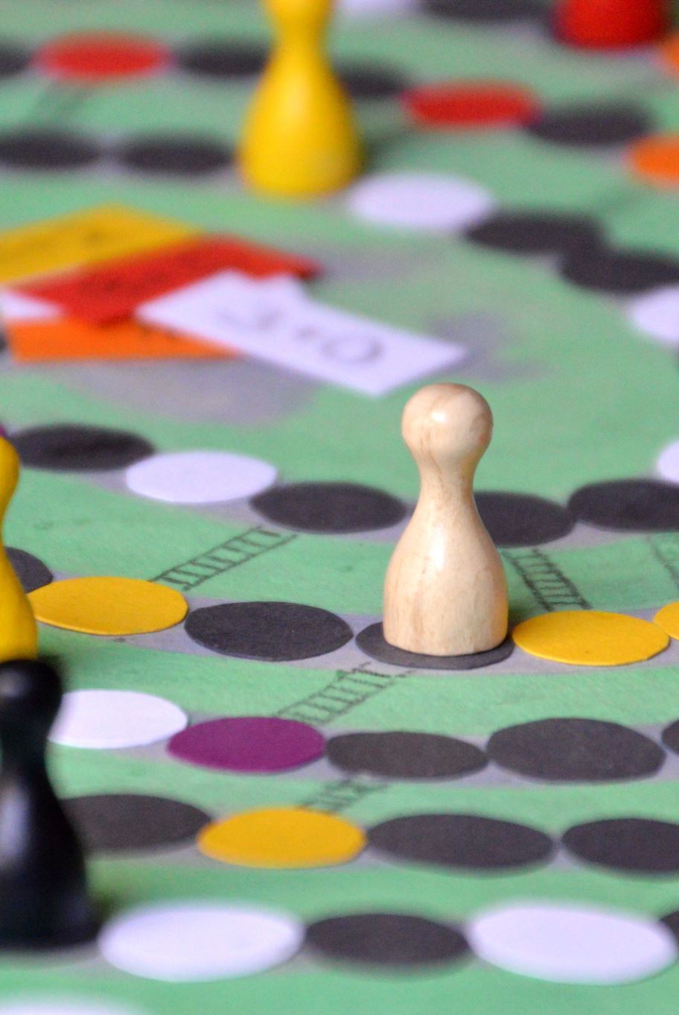
Parent selection
Two selection methods were implemented and compared
Roulette Wheel Selection
Tournament Selection
Notes:
For Parent Selection, I adopted two different strategies: tournament Selection and roulette wheel selection.
Tournament selection involves choosing the parent with the highest fitness from a pool of n parents. This approach might converge faster to a high-fitness solution but at the risk of getting stuck in local optima.
Roulette wheel selection, on the other hand, assigns a probability of being chosen as a parent to each individual in proportion to their fitness. This approach might maintain more diversity within the population compared to tournament selection, as there is a possibility that an individual with low fitness is chosen.
The crossover function generates a new individual from the genomes of two parents. A random value is selected between the target_preferences of the two parents, leaning towards the parent with higher fitness. The same is done for target_range. Moreover, once the value is selected, a random value between -0.1 and 0.1 is added to avoid getting stuck in a local optimum.

Slide 7
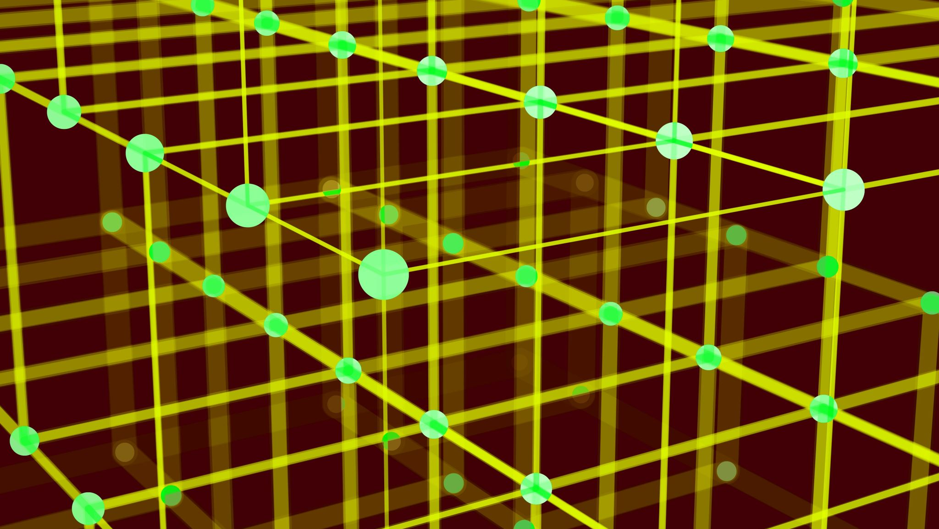
Simulation
10 Epochs: Represents the total number of generations the simulation will run through. Each epoch sees the creation of a new generation of individuals.
30 Number of Games per Individual: Indicates the number of games each individual in the population will play. It's crucial for determining the fitness of each individual.
Population (200): The total number of individuals in each generation. A larger population size allows for more genetic diversity.
100 Parents :The number of individuals selected as parents to create the next generation. This selection is key to passing successful traits forward.
Tournament Size (50): Used in tournament selection method. It's the size of the group from which one parent is selected based on fitness.
Mutation Rate (0.1) : The probability of a random mutation occurring in an individual's genome. Mutation introduces new genetic variations into the population.
Notes:
I conducted two simulations with these parameters:
10 epochs
25 matches per epoch
200 individuals as population
100 parents for each epoch
Tournament size of 50 individuals for the simulation with the Tournament selection strategy
0.1 as mutation rate, meaning that for each individual generated there is a 10% chance for each genome value to be randomly generated between 0 and 1

Slide 8

Result

Slide 9
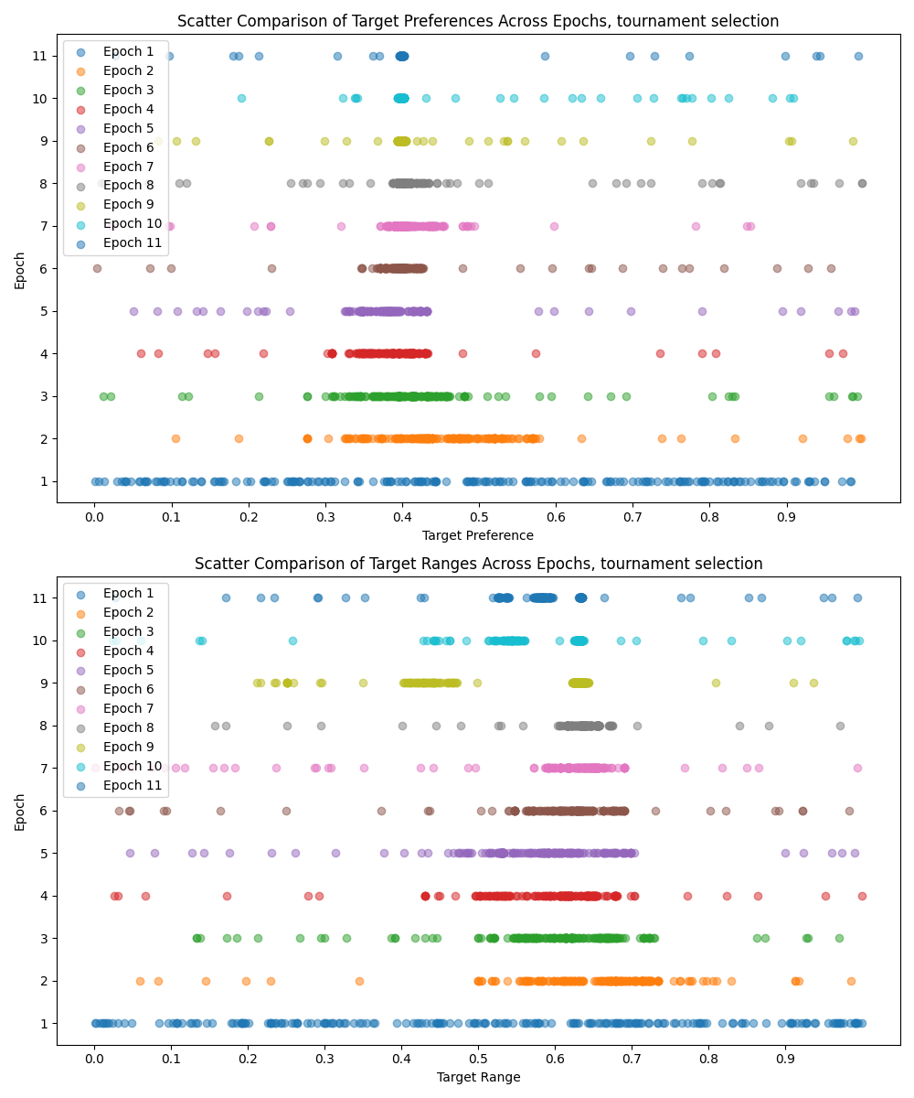
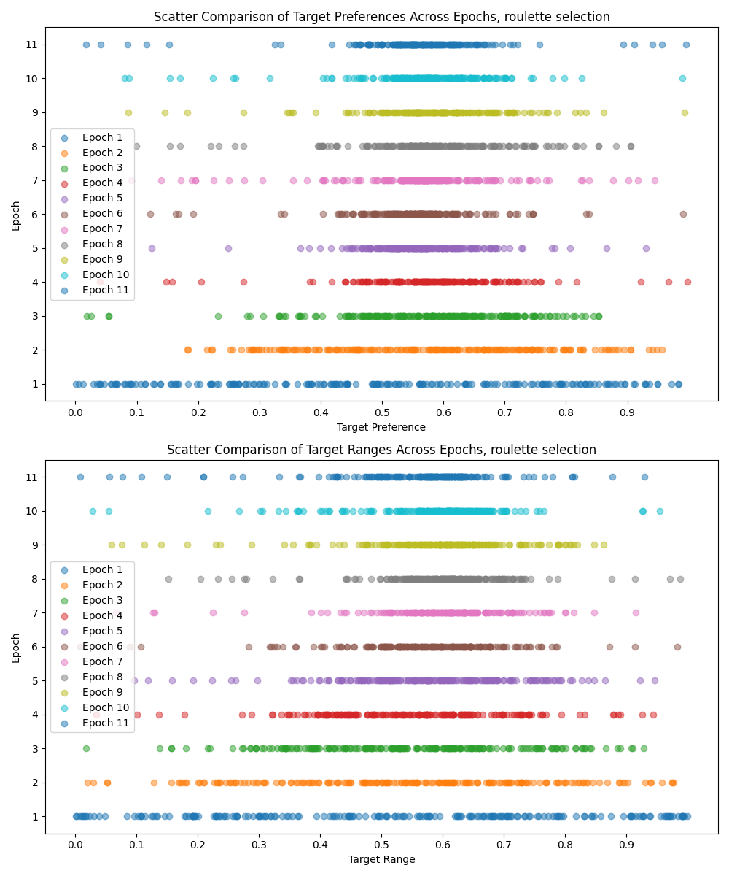
Tournament selection
Roulette wheel selection
Notes:
Once the simulations were executed, I generated several graphs to track the variability of the genome. As expected, we observed greater variance in the genome for the simulation implementing the roulette wheel strategy and rapid convergence for the simulation using the tournament selection strategy. We can appreciate that both simulations converge on a similar solution, avoiding moves that lead to a Nim sum of zero.

Slide 10
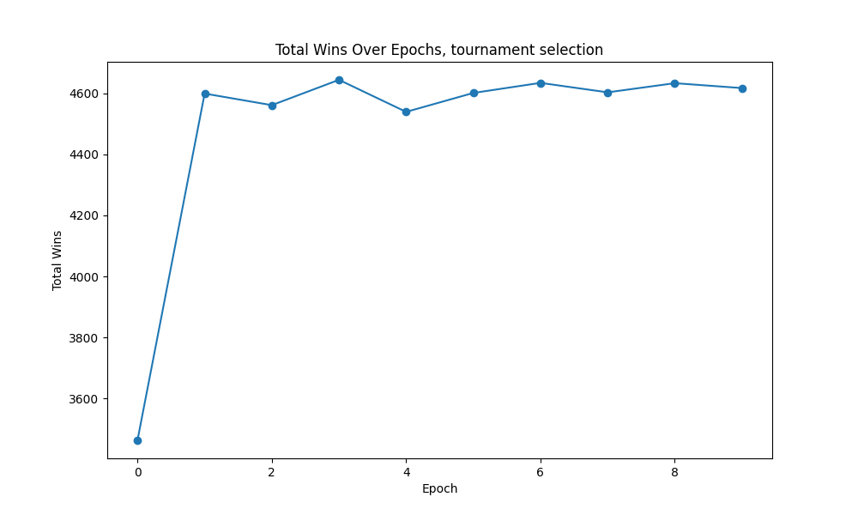
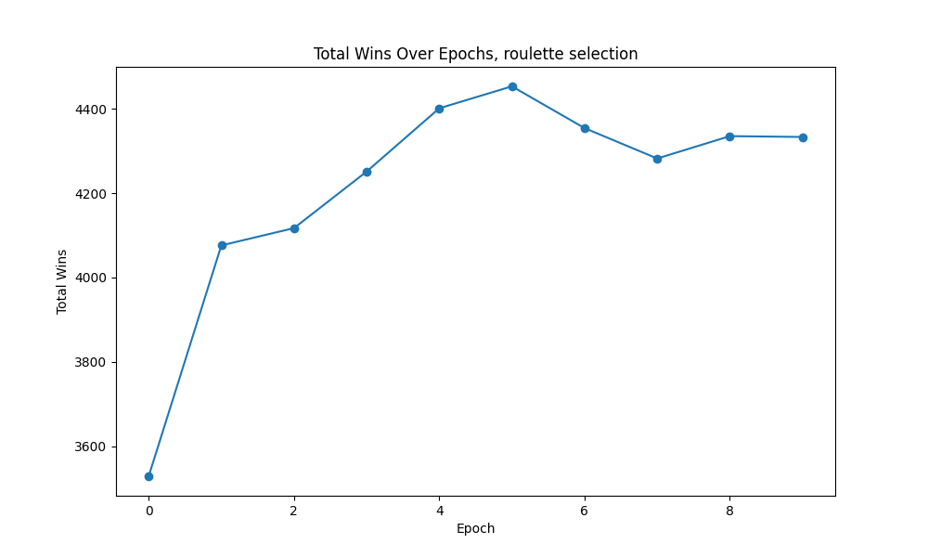
Tournament selection
Roulette wheel selection
Notes:
I also plotted the progression of victories for each epoch. These two graphs demonstrate that the simulation with the tournament selection strategy has a quicker convergence and a higher number of victories compared to the simulation done with roulette selection. We have a total number of victories that nearly reaches 4000, and on the other hand, number of victories is around 3500.

Slide 11
Tournament selection
Roulette wheel selection
Notes:
Finally, I created an animated heatmap that shows the number of victories per epoch in relation to the two genome attributes. On the x-axis, we have the target preference, and on the y-axis, we have the target range. The value of each cell represents the number of victories for individuals with that specific genome configuration.

Slide 12
Thanks for the attention
Alessandro De Marco - 317626 – github: Aleedm

